Slide 1



Find factors of numbers up to 40.
How would you describe this array of counters?
Mathematicians like us would say that it is
6 by 4.
What other arrays of 24 counters can you make?
Draw them.
Remember that each column and each row must have the same number of counters...

Slide 2
Find factors of numbers up to 40.
8 by 3
6 by 4
Did you find them all?
12 by 2
24 by 1

Slide 3
Find factors of numbers up to 40.
24 is a multiple of 1, 2, 3, 4, 6, 8, 12 and 24.
These numbers are called its factors.
Factors are numbers that will ‘go into’ 24 without any left over.
Factors almost always come in pairs, e.g. 6 and 4.
Write down the other factor pairs for 24. How many pairs are there altogether?
1
24
2
24
12
3
8
4
6
There are 4 factor pairs for 24.
6 and 4, 8 and 3, 12 and 2 and 24 and 1.

Slide 4
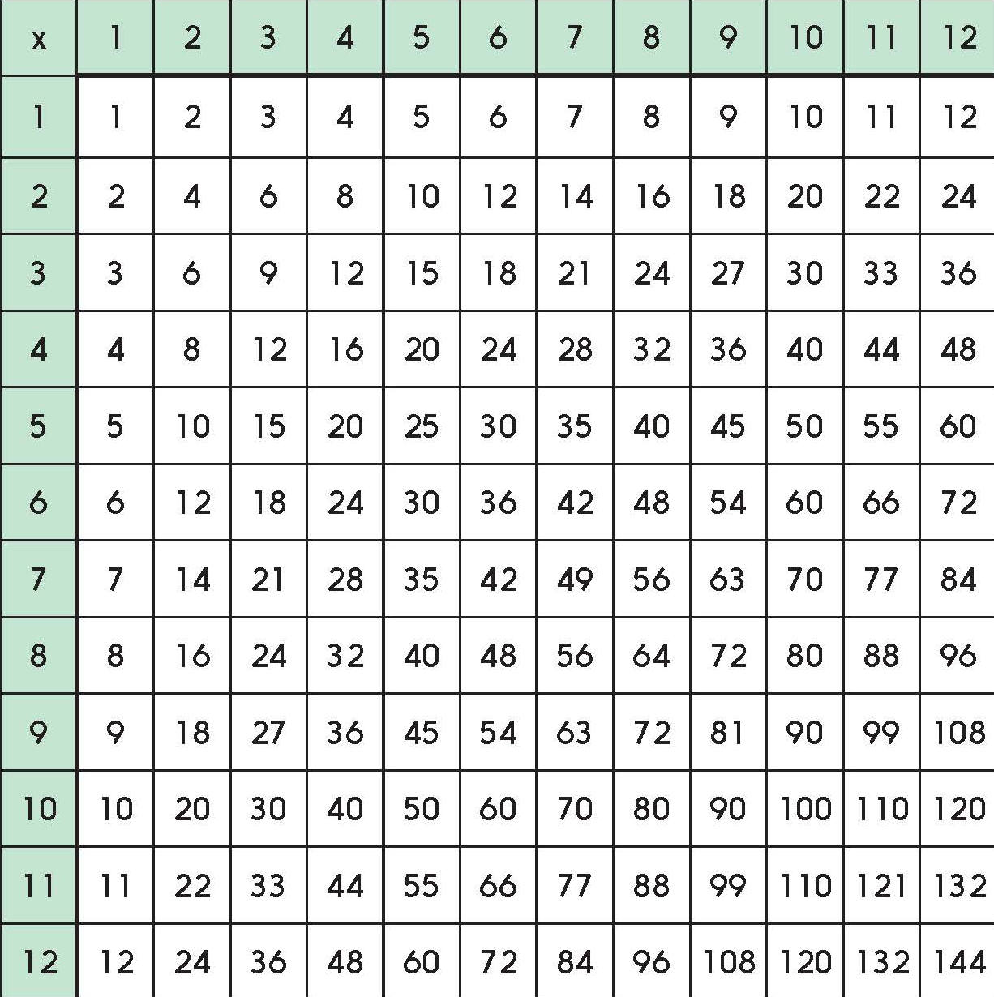
Explore the factors of numbers to 144.
Write some multiplication facts with the answer 18.
18 appears on this multiplication grid in
four places.
18 is in the 2, 3, 6 and 9 times tables. 1 × 18 also makes 18, so 18 has three pairs of factors…
… 3 and 6, 2 and 9 and 1 and 18.

Slide 5
Explore the factors of numbers to 144.
Let’s check some…
14, 22, 35, 77…
Those numbers all have 4 factors; can you explain why?
e.g. factors of 22 are 2 & 11, 1 & 22

