Slide 1

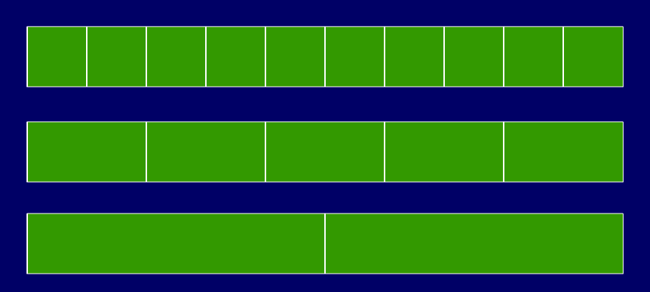

Identify equivalent fractions and mark them on a number line.
¹/₁₀s
¹/₅s
¹/₂s
Find pairs of equivalent fractions on these fraction strips.
There are 5 pairs – can you find them all?

Slide 2
Identify equivalent fractions and mark them on a number line.
¹/₁₀s
¹/₅s
¹/₂s
²/₁₀ = ¹/₅
⁴/₁₀ = ²/₅
⁶/₁₀ = ³/₅
⁸/₁₀ = ⁴/₅
⁵/₁₀ = ¹/₂
For each pair of equivalent fractions, which is the simplest form?

Slide 3
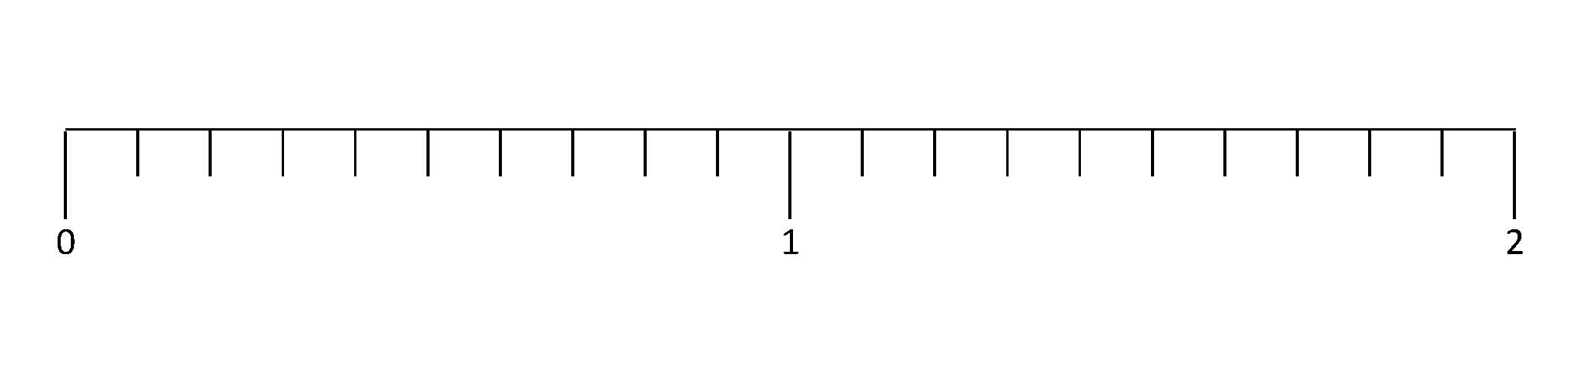

Identify equivalent fractions and mark them on a number line.
¹/₅
1²/₅
²/₁₀
⁹/₁₀
1⁴/₁₀
It is equivalent to ²/₁₀ .
The number line is divided into tenths, so where does ¹/₅ go?
Where does ⁹/₁₀ go? Can it be simplified?
What about 1⁴/₁₀ ? Can it be simplified?

Slide 4
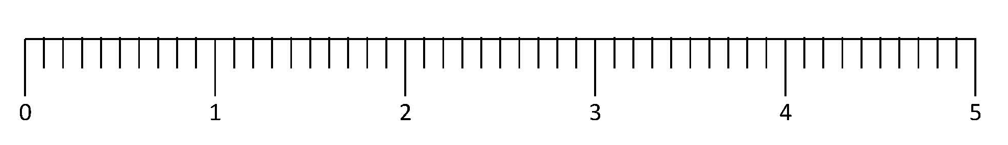
Mark equivalent fractions and decimals on a number line.
0.6
1.8
3.5
4.3
Let’s count along the line in tenths
from 0 to 2….
What decimal is the arrow is pointing to?

Slide 5
Mark equivalent fractions and decimals on a number line.
¹/₂
1¹/₅
2⁷/₁₀
3³/₁₀
4³/₅
0.5
1.2
2.7
3.3
4.6
Remember we can write equivalent fractions for each decimal, for example 0.1 ≡ ¹/₁₀ .
Write the decimal and the equivalent fraction the arrow is pointing to.
If possible, write the fraction in its simplest form.

