Slide 1
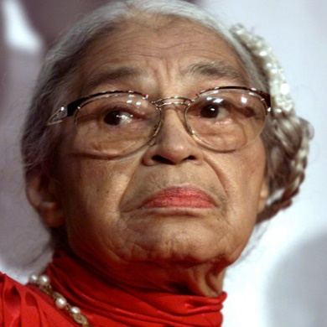
KS1 Topic: Famous for More than Five Minutes Block E: Activists Session 1
Rosa Parks?
Who was
Objectives:
To understand that Rosa Parks’ story holds global significance
To be able to express your opinion on the story of Rosa Parks
To understand our lives are connected to the lives of others around the world
© Original resource copyright Hamilton Trust, who give permission for it to be adapted as wished by individual users.
We refer you to our warning, at the foot of the block overview, about links to other websites.

Slide 2
The world that Rosa was born into:
The black community are segregated from the white community.
Segregated means to be kept apart

Slide 3
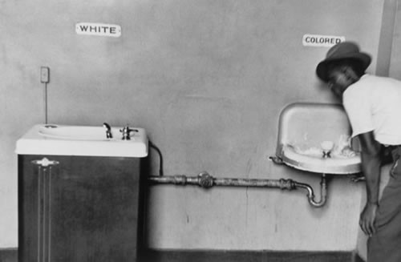

Slide 4
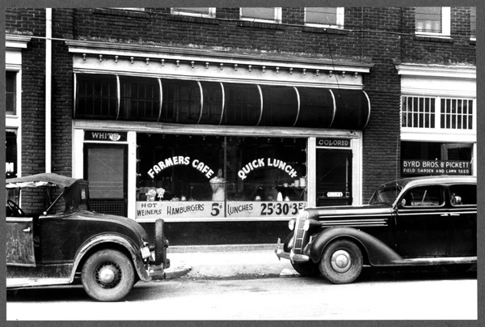

Slide 5
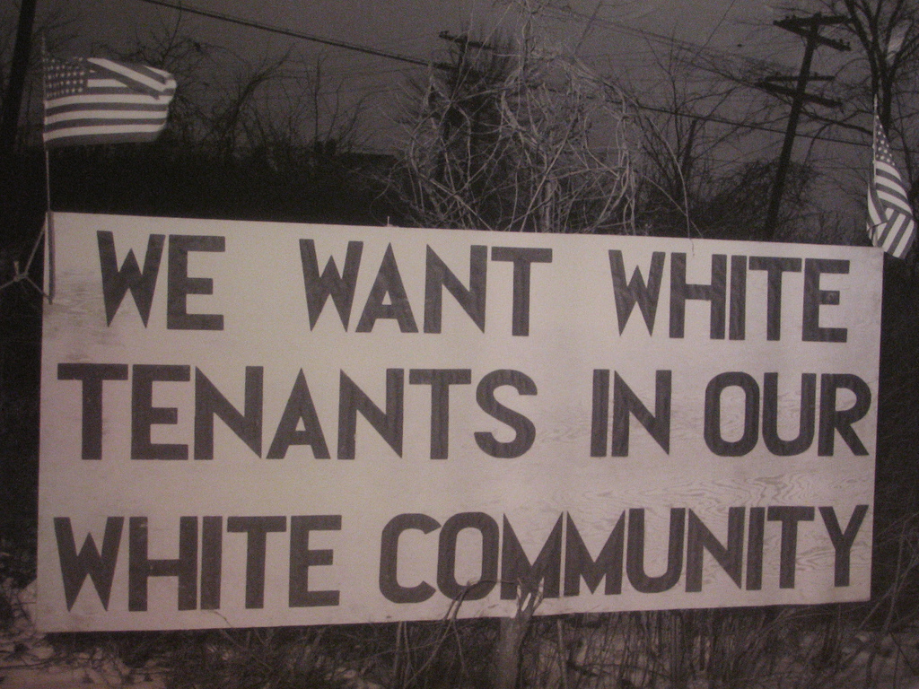

Slide 6
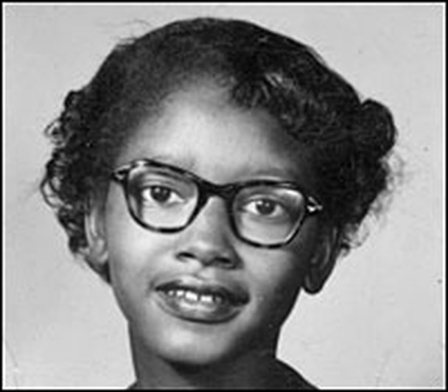
Early Life
Rosa McCauley was born in Tuskegee, Alabama, America on February 4, 1913. Her dad was called James and her mother Leona. At age two she moved to move in with her grandparents. Her brother, Sylvester, was born in 1915, and shortly after that her parents separated.
Take a look at a world map or atlas to see how far away America is from the UK.

Slide 7
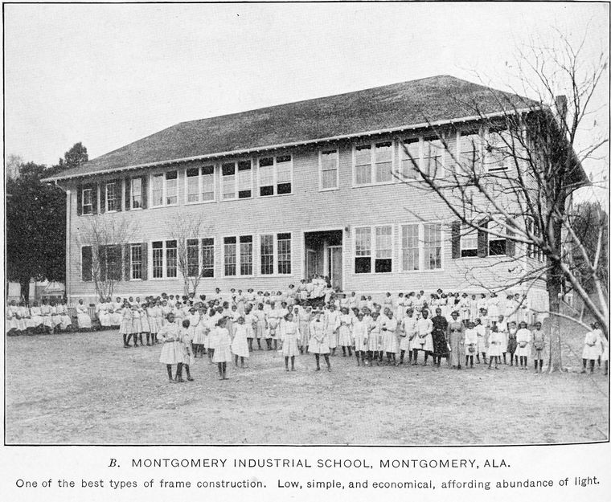
Schooling
After attending rural schools in December 1924 Rosa, aged eleven, started at Mrs White’s school for girls. Rosa’s mother was a teacher and taught her that learning was important. Rosa’s school was for black children only.
Rosa had to drop out of school aged 16 because she needed to care for her dying grandma then look after her mum as she wasn’t very well.

Slide 8
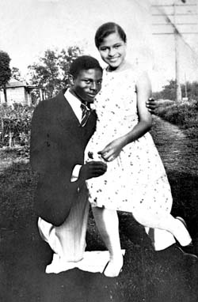
Marriage
In 1932, at 19, she married Raymond Parks, a self-educated man 10 years her senior who worked as a barber and was a long-time member of the National Association for the Advancement of Coloured People (NAACP).
He supported Rosa in her efforts to earn her high-school diploma, which she ultimately did the following year.
We now think of the term coloured as insulting, so today it is not used.

Slide 9
Work
Raymond and Rosa, who worked as a seamstress, became respected members of Montgomery’s large African-American community. Co-existing with white people in a city governed by segregation laws. However, daily life was full of frustrations: Blacks could attend only certain (inferior) schools, could drink only from specified water fountains, could borrow books only from the “black” library, these are just a few of the restrictions.
Rosa Parks became secretary of the National Association for the Advancement of Coloured People (NAACP.) This organisation wanted to change the segregation laws because they said they weren't fair.

Slide 10
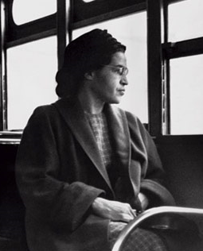
December 1st 1955.
Rosa Parks was travelling home on the buses from a day at her work as a seamstress…

Slide 11
On the buses, black people were made to sit in the back rows
Whilst the white people took the four rows at the front of the bus
x

Slide 12
But if the front rows were full
The black passengers were expected to give up their seats
x

Slide 13
She took a seat labelled for ‘coloured people’
x
Rosa’s seat

Slide 14
After a few stops, the seats
began to fill…

Slide 15
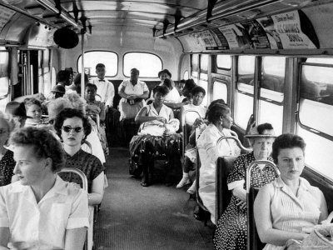

Slide 16
When a white man entered the bus, the driver insisted that Rosa and the three other passengers on her row give up their seats for him…

Slide 17
Rosa refused.

Slide 18
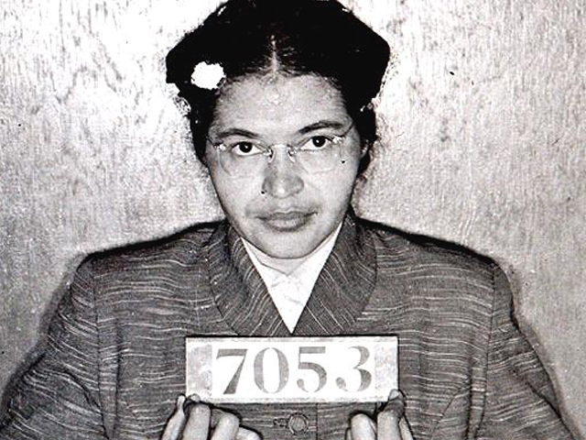

Slide 19
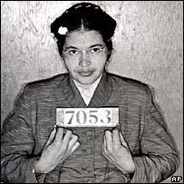
She was arrested and tried on charges of ‘disorderly conduct’

Slide 20
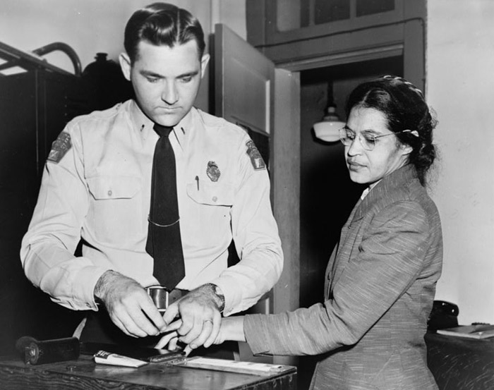
Rosa Parks believed in a world where black and white communities could live and work together

Slide 21
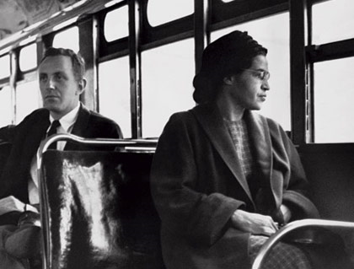
The Bus Boycott
The message soon spread about Rosa Parks’ arrest. The black community decided to stop using the buses on 5th of December 1955. We call this boycotting* the buses. They boycotted the buses to show that they didn’t like the fact that coloured people only had a few seats. They thought this was unfair. In the evening over 4,000 people came to a church meeting to make a plan.
On the day of the bus boycott 5th of December 1955 Rosa was found guilty of breaking segregation laws and fined $14.
People were outraged. How was this fair?
*Boycotting means to stop using something or buying something to show that you that you think the company are making a bad choice.

Slide 22
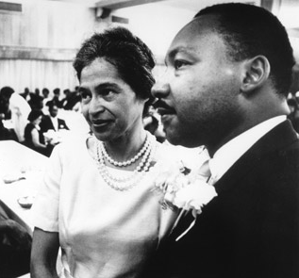
What happened next?
It took many years for changes to come about. Dr Martin Luther King worked with Rosa Parks and many other African Americans. Martin Luther King wrote a book about the Montgomery bus boycott called Stride to Freedom.
Around 1968, 13 years after Rosa Parks refused to give up her seat, the laws began to change. This meant that segregation laws slowly began to stop.
Rosa Parks’ courageous acts inspired the world.

Slide 23
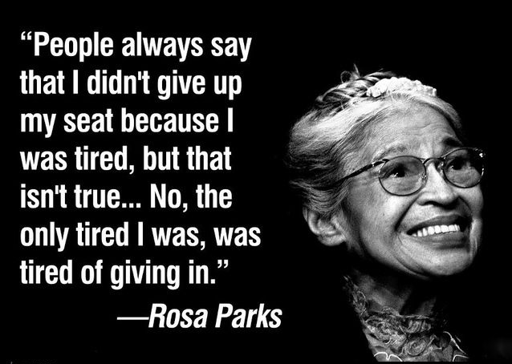

Slide 24
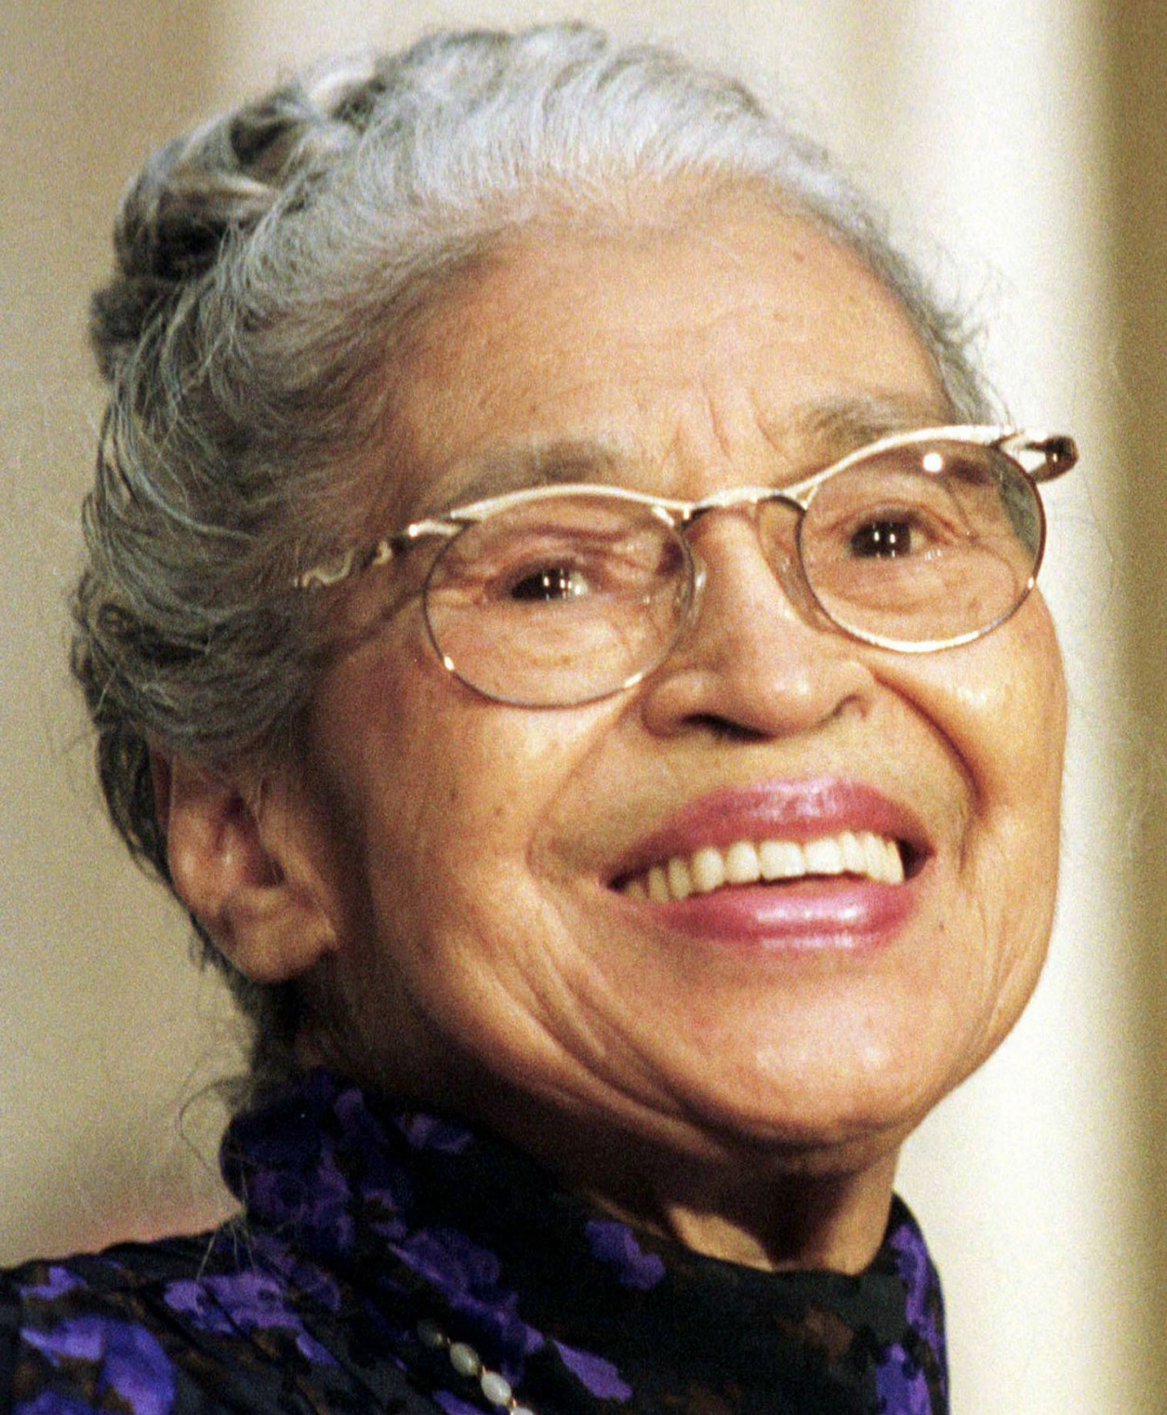

Slide 25
"My message to the world is that we must
come together and live as one."
- Rosa Parks

