Slide 1
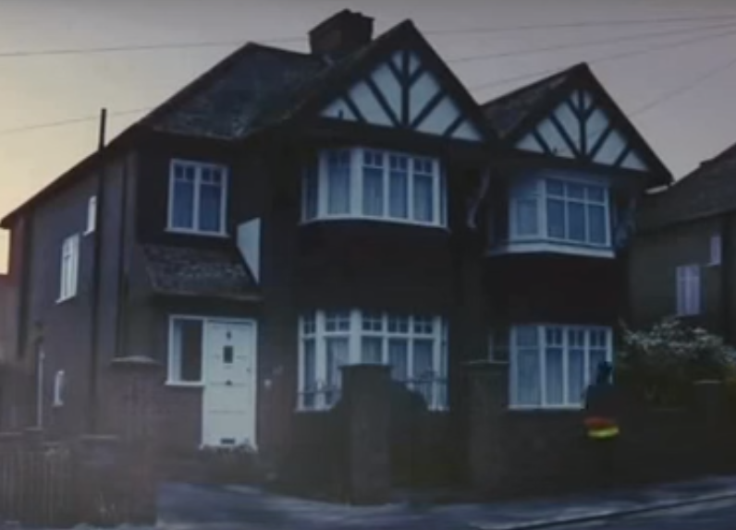
What does the word ‘anticipation’ mean?
Which nativity character is the boy dressed as?
What does the boy do to show he is frustrated?
https://www.youtube.com/watch?v=IBtHj0674Is
How does the director surprise the viewer at the end of the advert?

Slide 2
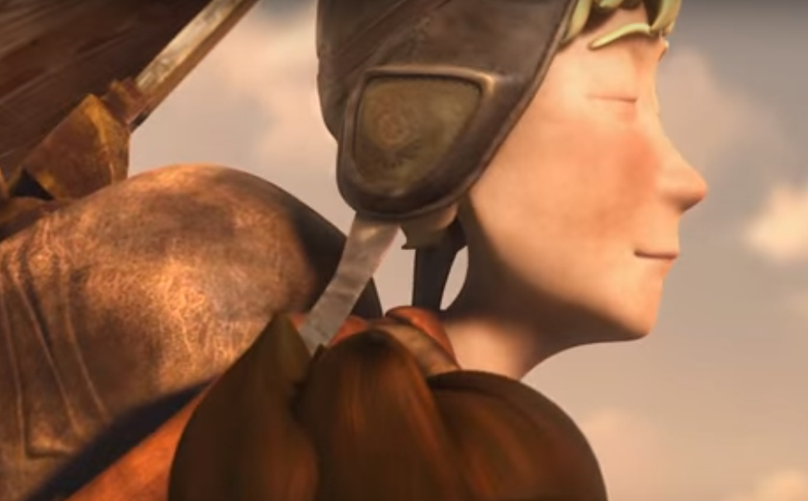
What does the word ‘legacy’ mean?
How many picture frames are on the mantelpiece?
What different emotions does the man on the clifftop experience?
https://www.youtube.com/watch?v=tl00xSaYOiI
How does the director use music to add meaning to the film?

Slide 3
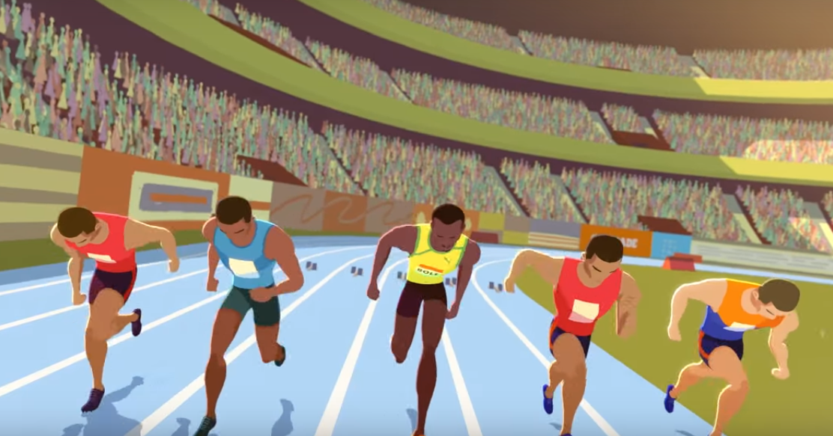
What does the phrase ‘keep it light’ mean?
What does the coach say he needs to do if he wants to be great?
How is Usain feeling after he reads the newspaper and how can you tell?
https://www.youtube.com/watch?v=6b03jWW70kc
How does the director use colour to show the change in emotion?

Slide 4
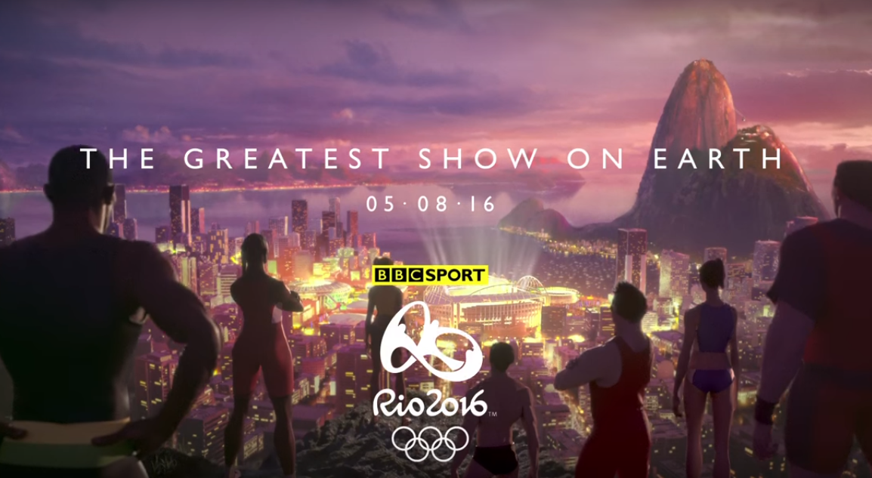
What does the word ‘Olympian’ mean?
What different Olympic events are happening in the video?
How can you tell that the animals are determined to succeed?
https://www.youtube.com/watch?v=CKcEySuuUuE
Why do you think the director chose this piece of music for this advert?

Slide 5
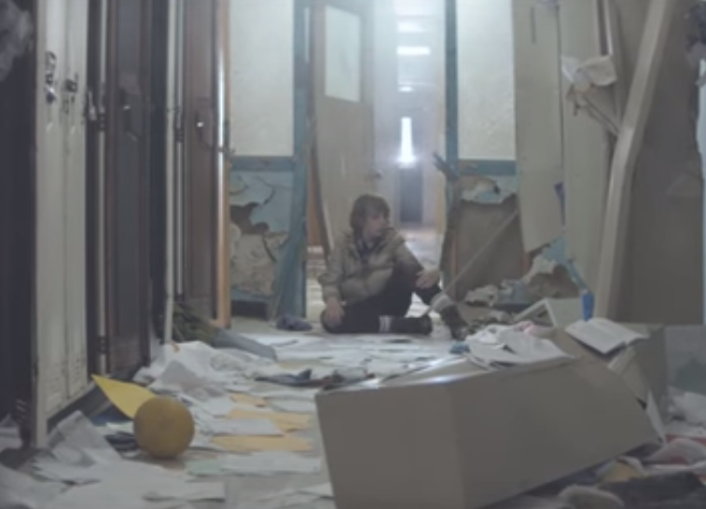
What does the word ‘supernatural’ mean?
What colours are in the boy’s hat?
How can you tell that the teacher is scared of the boy?
https://www.youtube.com/watch?v=JRfuAukYTKg
How has the director matched the events in the film to the music?

Slide 6
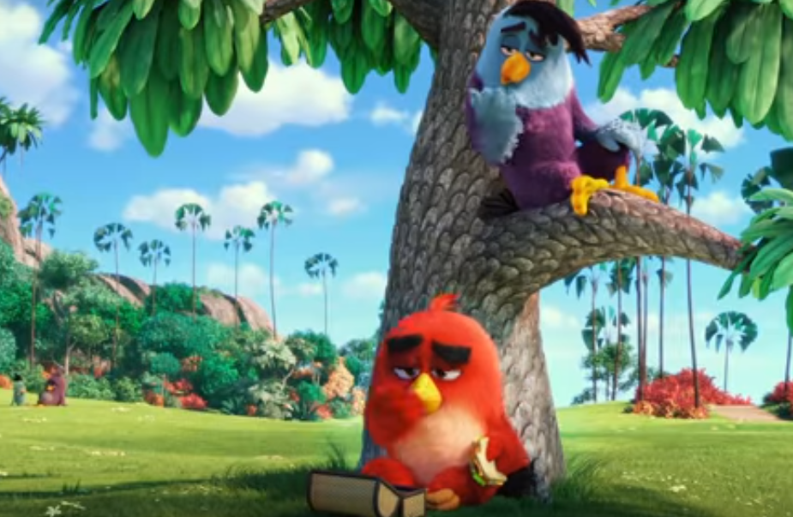
What does the word ‘unrequited’ mean?
What colour is the pig?
Why could Red be described as an Angry Bird?
https://www.youtube.com/watch?v=1U2DKKqxHgE
Why do you think the director chose two different pieces of music?

Slide 7
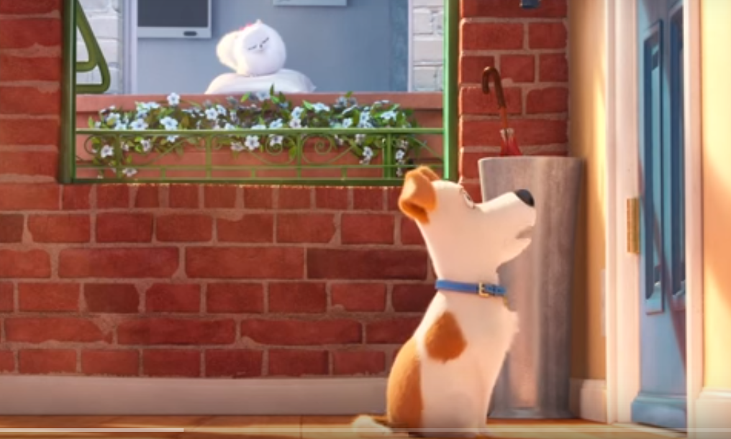
What does the word ‘trailer’ mean?
What is the cat called?
How can you tell that the cat really wants to eat the food?
https://www.youtube.com/watch?v=UZ4WBlveGfw
How does the director surprise us with the dog’s behaviour at the end?

Slide 8
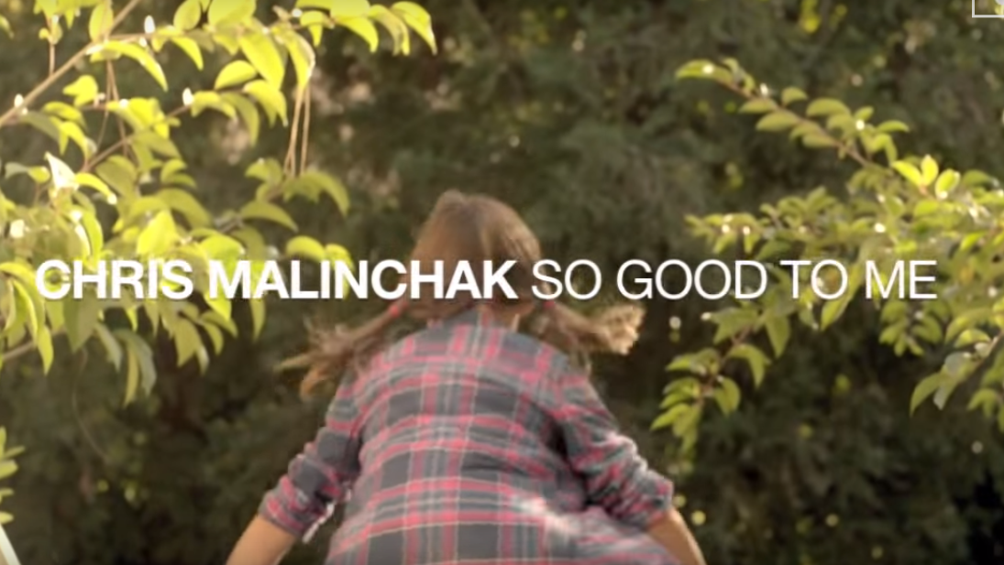
What does the word ‘mystery’ mean?
What colours are in the girl’s shirt?
How can you tell that the girl is excited to go outside?
https://www.youtube.com/watch?v=aUytlFrfmrU
What clues does the director give us as to the mystery pet’s identity?

Slide 9
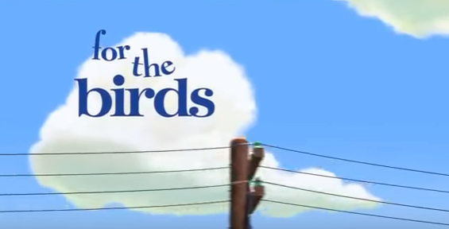
What does the word ‘ridicule’ mean?
What colour are the birds?
How can you tell the little birds don’t like the big bird?
https://www.youtube.com/watch?v=pWIVoW9jAOs
Why do you think the director chose the end the film in this way?

